Slide 1
Recurrence Relations
Overview
  Connection to recursive algorithms
Techniques for solving them
  Methods for generating a guess
  Substition method
  Induction proofs
  Master Theorem

Slide 2
Recursion and Mathematical Induction
In both, we have general and boundary conditions:
  The general conditions break the problem into smaller and smaller pieces.
  The initial or boundary condition(s) terminate the recursion.
Both take a Divide and Conquer approach to solving mathematical problems.

Slide 3
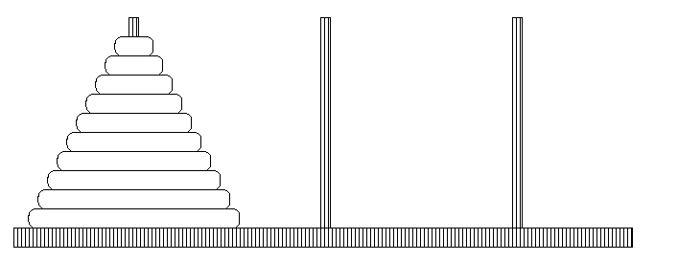
The Towers of Hanoi

Slide 4
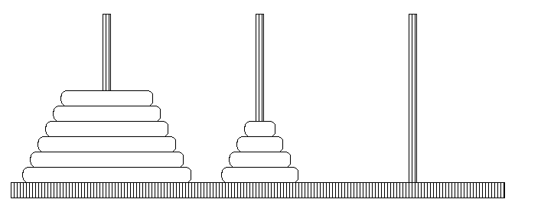
What if we knew we could solve part of the problem?
Assume we can move k (in this case, 4) different rings

Slide 5
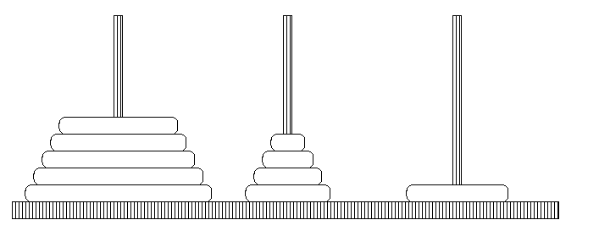
Can we do one better?

Slide 6
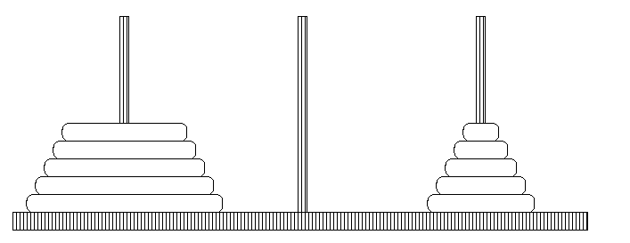
Solved for one more!

Slide 7
Where do recurrence relations come from?
Analysis of a divide and conquer algorithm
  Towers of Hanoi, Merge Sort, Binary Search
Analysis of a combinatorial object
This is the key analysis step I want you to master
Use small cases to check correctness of your recurrence relation

Slide 8
Recurrence Relations
Overview
  Connection to recursive algorithms
Techniques for solving them
  Methods for generating a guess
  Induction proofs
  Master Theorem

Slide 9
Solving Recurrence Relations
No general, automatic procedure for solving recurrence relations is known.
There are methods for solving specific forms of recurrences
Links to some good sites with more info:
  Wikipedia: http://en.wikipedia.org/wiki/Recurrence_relation
  SUNY-SB web site: http://www.cs.sunysb.edu/~algorith/lectures-good/node3.html

Slide 10
Mathematical Induction
A powerful, rigorous technique for proving that a statement T(n) is true for every natural number n, no matter how large.
Proof:
  Basis step: prove that the statement is true for n = 1
  Inductive step: assume that T(n) is true and prove that T(n+1) is true for all n ≥ 1
Find case n “within” case n+1

Slide 11
Example
Prove that: 2T(n-1) + 1 ≤ 2^{n} - 1 for all n ≥ 0
T(0) = 0
Basis step:
  T(0) = 2⁰ – 1, n = 0 TRUE
Inductive step:
  Assume inequality is true for n, and prove it for (n+1):
  T(n) ≤ 2^{n} – 1 must prove: T(n + 1) ≤ 2^{n+1} - 1
  T(n+1) = 2T((n + 1)-1) + 1 = 2T(n) + 1
  =2 (2^{n} - 1 ) +1 =2^{n+1}-1
  ≤ 2^{n} + 2 = 2^{n+1}, since 2 ≤ 2^{n} for n ≥ 1

Slide 12
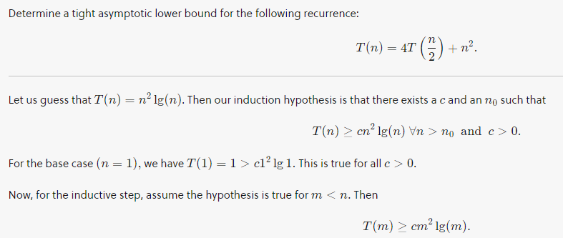
Substitution Method for Solving Recurrences
Guess the form of the solution.
Use induction to show that the guess is valid.

Slide 13
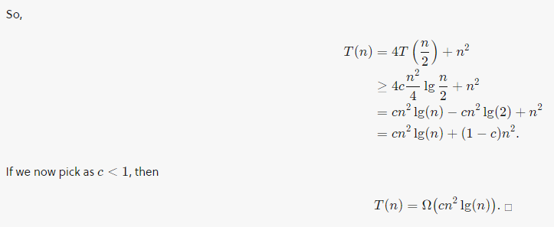


Slide 14
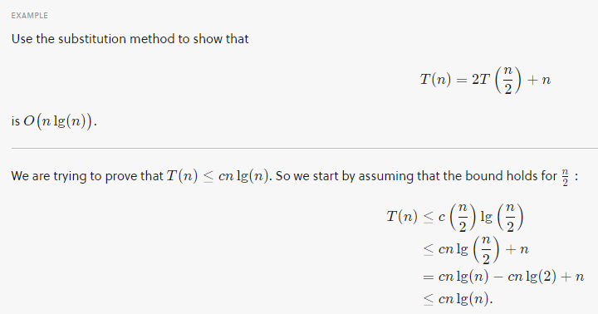

Slide 15
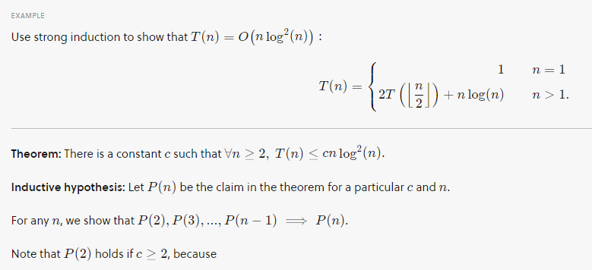

Slide 16
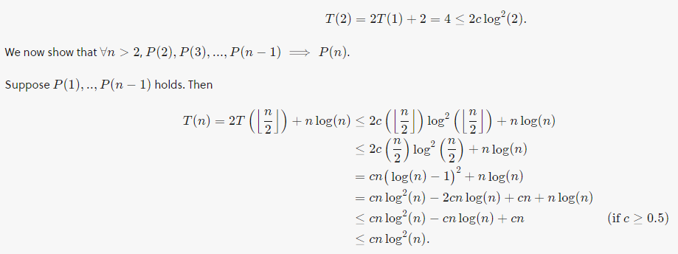

Slide 17
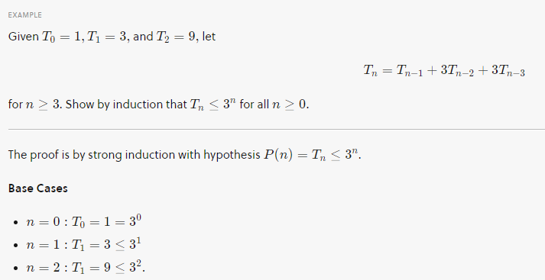

Slide 18
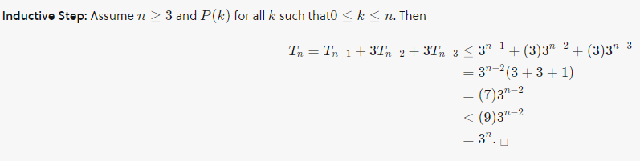

Slide 19
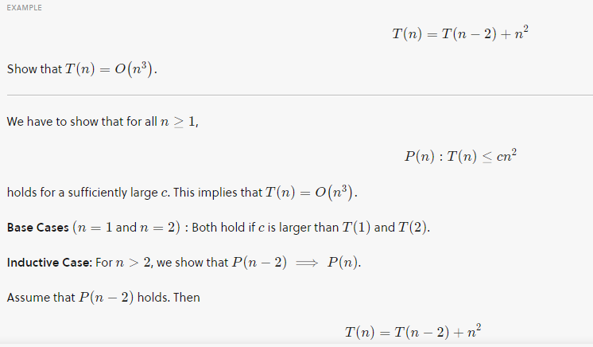

Slide 20
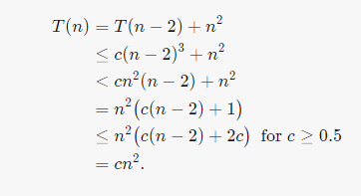

Slide 21
Some Solution Techniques
Guess a solution and prove by induction.
  Extrapolate from small values
  Try back-substituting
  Draw a recursion tree
Master Theorem
  Quick solutions for many simple recurrences

Slide 22
Extrapolate from small values
Example: T_{n} = 2T_{n-1} + 1 ; T₀ = 0
n = 0 1 2 3 4 5 6 7
T_{n}=
Guess:

Slide 23
Back-substitution or Unrolling
T_{n} = 2T_{n-1} + 1 ; T₀ = 0
T_{n} = 2(2T_{n-2} + 1) + 1
= 4T_{n-2} + 2 + 1
T_{n} = 4(2T_{n-3} + 1) + 2 + 1
= 8T_{n-3} + 4 + 2 + 1
T_{n} = 8(2T_{n-4} + 1) + 4 + 2 + 1
= 16T_{n-4} + 8 + 4 + 2 + 1
Guess:

Slide 24
Recursion Trees
T_{n} = 2 T_{n-1} + 1 , T₀ = 0
T_{n}
1
1
T_{n-1}
T_{n-1}
1
1
2
T_{n-2}
T_{n-2}
T_{n-2}
T_{n-2}
1
1
1
1
4
Guess:

Slide 25
Extrapolate from small values
Example: T(n) = 3T(⎣n/4⎦) + n, T(0) = 0
n = 0 1 2 3 4 5 6 7 8 9 10 11 12 13
T(n)=
n = 0 1 4 16 64 256 1024
T(n)=
Guess:

Slide 26
Back-substitution or unrolling
T(n) = 3T(⎣n/4⎦) + n, T(0) = 0
≤ 3(3T(n/16)+ n/4) + n
= 9T(n/16) + 3n/4 + n
= 9(3T(n/64) + n/16) + 3n/4 + n
= 27T(n/64) +9n/16 + 3n/4 + n
Guess:

Slide 27
Recursion Trees
T_{n} = 3T_{⎣n/4⎦} + n, T₀ = 0
T_{n}
n
n
T_{n/4}
T_{n/4}
T_{n/4}
3n/4
n/4
n/4
n/4
T_{n/16}
T_{n/16}
T_{n/16}
T_{n/16}
T_{n/16}
T_{n/16}
n/16
n/16
n/16
9n/16
n/16
n/16
n/16
n/16
n/16
n/16
T_{n/16}
T_{n/16}
T_{n/16}
Guess:

Slide 28
Third Example
Example: T_{n} = 2 T_{n/2} + n² , T₀ = 0
Generate a potential solution using the 3 different techniques

Slide 29
Example: D&C into variable sized pieces
T(n) = T(n/3) + T(2n/3) + n
T(1) = 1
Generate a potential solution for T(n) using the methods we have discussed.

Slide 30
Recurrence Relations
Overview
  Connection to recursive algorithms
Techniques for solving them
  Methods for generating a guess
  Induction proofs
  Master Theorem

Slide 31
Induction Proof
T_{n} = 2T_{n-1} + 1 ; T₀ = 0
Prove: T_{n} = 2^{n} - 1 by induction:
1. Base Case: n=0: T₀ = 2⁰ - 1 = 0
2. Inductive Hypothesis (IH): T_{n} = 2^{n} – 1 for n ≥ 0
3. Inductive Step: Show T_{n+1} = 2^{n+1} – 1 for n ≥ 0
T_{n+1} = 2T_{n} + 1
= 2 ( 2^{n} - 1 ) + 1 (applying IH)
= 2^{n+1} -1

Slide 32
Merge sort analysis
Mergesort(array)
n = size(array)
if ( n = = 1) return array
array1 = Mergesort(array[1 .. n/2])
array2 = Mergesort(array[n/2 + 1 .. n])
return Merge(array1, array2)
Develop a recurrence relation:

Slide 33
Merge Sort Induction Proof
Prove that T(n) = 2T( ⎣n/2⎦ ) + n , T(1) = 1 is O(n lg n).
Prove that T(n) ≤ c n lg n , for all n greater than some value.
Base cases: why not T(1)?
T(2) = 4 ≤ c 2 lg 2
T(3) = 5 ≤ c 3 lg 3
c ≥ 2 suffices
Inductive Hypothesis: T(⎣n/2⎦ ) ≤ c (⎣n/2⎦ ) lg (⎣n/2⎦ ) for n ≥ ?
Inductive Step: Show that T(n) ≤ c n lg n for n ≥ ?

Slide 34
Induction Step
Given : T(⎣n/2⎦ ) ≤ c (⎣n/2⎦ ) lg (⎣n/2⎦ )
T(n) = 2T( ⎣n/2⎦ ) + n
≤ 2( c(⎣n/2⎦) log (⎣n/2⎦) ) + n (applying IH)
≤ 2( c(n/2) log (n/2) ) + n (dropping floors makes it bigger!)
= c n lg(n/2) + n
= c n ( lg(n) - lg(2) ) + n
= c n lg(n) - c n + n (lg 2 = 1)
= c n lg(n) - (c - 1) n
< c n lg(n) (c > 1)

Slide 35
Recurrence Relations
Overview
  Connection to recursive algorithms
Techniques for solving them
  Methods for generating a guess
  Induction proofs
  Master Theorem

Slide 36
Master Theorem
T(n) = a T(n/b) + f(n)
  Ignore floors and ceilings for n/b
  constants a ≥ 1 and b > 1
  f(n) any function
If f(n) = O(n^{log_b} ^{a-ε}) for constant ε>0, T(n) = Θ(n^{log_b a})
If f(n) = Θ(n^{log_b} ª), T(n) = Θ(n^{log_b a} lg n)
If f(n) = Ω(n^{log_b} ^{a+ε}) for some constant ε >0, and if a f(n/b) ≤ c f(n) for some constant c < 1 and all sufficiently large n, T(n) = Θ(f(n)).
Key idea: Compare n^{log_b a} with f(n)

Slide 37
Applying Master Theorem
Master Theorem: T(n) = a T(n/b) + f(n)
  Key idea: Compare n^{log_b a} with f(n)
T_{n} = 2T_{n-1} + 1 ; T₀ = 0
T(n) = 3T(⎣n/4⎦) + n, T(1) = 1
T(n) = 2T( ⎣n/2⎦ ) + n , T(1) = 1
T(n) = T(n/3) + T(2n/3) + n

Slide 38
Problem: Merge Sort
Merge sort breaking array into 3 pieces
  What is a recurrence relation?
  What is a solution?
  How does this compare to breaking into 2 pieces?

